Slide 1
Demi Lovato

Slide 2
Early Life
- Born August 20,1992.
- Lived with mom, Dallas and Madison.
- Bullied
- Barney and Friends age of 10.

Slide 3
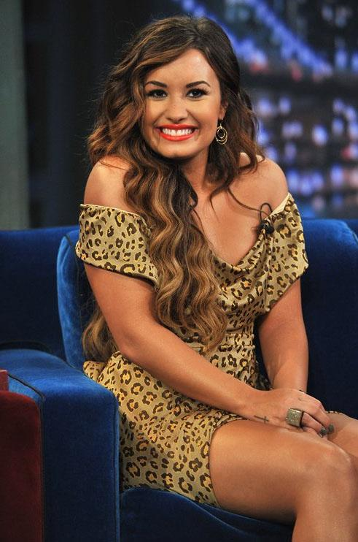
Acting Career
- As the Bell Rings
- Camp Rock
- Sonny with a Chance
- Princess Protection Program

Slide 4
Rehab
- Second album.
- Depression, self harm, bulimia, anorexia and bipolar disorder.
-Checked out in January 2011.

Slide 5
Unbroken
- X Factor judge.
- Third album Unbroken
- Newest album DEMI

Slide 6
Video Clip
http://www.youtube.com/watch?v=KG9dw7SeW6o

Slide 7
Extra Information
- Against Bullying
- Stay Strong tatoos
- 3 octave vocal range
-http://www.youtube.com/watch?feature=player_embedded&v=ahU5X1PVPH0

Slide 8
Video Clip
http://www.mtv.com/videos/news/746197/demi-lovato-stay-strong-finding-a-bigger-purpose.jhtml#id=1680480

Slide 9
Questions
1. Do you think Demi Lovato is a good role model? Explain your answer.
2. Why do you think people judge her because of her struggles?
3. If Demi never told the public her story how would it affect the world?

Slide 10
Work Cited
"DEMI." Page to Premiere. N.p., n.d. Web. 24 May 2013. <http://pagetopremiere.com/2013/05/listen-fire-starter-by-demi-lovato-matches-divergent-eerily-jumping-off-a-moving-train-theres-nothing-more-to-be-afraid-of/>.
Demi Lovato. N.p., n.d. Web. 24 May 2013. <http://www.demilovato.com/>.
"Demi Lovato." Celebrity Photos. N.p., n.d. Web. 24 May 2013. <http://celebrityphotos.sheknows.com/celebrity-styles/demi-lovato-looks-fierce-on-jimmy-fallon/>.
"Demi Lovato." Degrassi Wiki. N.p., n.d. Web. 24 May 2013. <http://degrassi.wikia.com/wiki/File:Demi-lovato-girl-long-hair-blonde-pink-beauty-tatto-fashion_large.jpg>.
Demi Lovato Daily. N.p., n.d. Web. 24 May 2013. <http://www.demilovatodaily.com/>.
Demi Lovato- Skyscraper. YouTube. N.p., n.d. Web. 24 May 2013. <http://www.youtube.com/watch?v=KG9dw7SeW6o>.
Demi Lovato Vocal Range. YouTube. N.p., n.d. Web. 24 May 2013. <http://www.youtube.com/watch?feature=player_embedded&v=ahU5X1PVPH0>.
Finding a Bigger Purpose. MTV. N.p., n.d. Web. 24 May 2013. <http://www.mtv.com/videos/news/746197/demi-lovato-stay-strong-finding-a-bigger-purpose.jhtml#id=1680480>.
"Here We Go Again." Star Doll Tutorials. N.p., n.d. Web. 24 May 2013. <http://stardolltutorials.wordpress.com/2010/08/26/demi-lovato-makeup-tutorial-from-%E2%80%9Chere-we-go-again%E2%80%9D/>.

